Slide 1
Database Security
Md. Iftekharul Alam Efat

Slide 2
Learning Objectives
Understand the unique need for database security, separate from ordinary computer security measures
Present an overview of the basic elements of a database management system
Present an overview of the basic elements of a relational database system
Define and explain SQL injection attacks
Compare and contrast different approaches to database access control
Explain how inference poses a security threat in database systems
Discuss the use of encryption in a database system
Present an overview of cloud computing concepts
Understand the unique security issues related to cloud computing

Slide 3
The NEED
Imbalance between modern DBMS & Security Techniques
Interaction of SQL with Web Service through HTTP
Mismatch between Requirements and Capabilities
Heterogeneous mixture of Database platforms

Slide 4
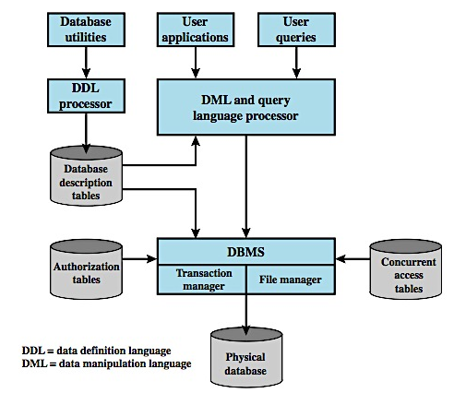
DBMS Architecture
Notes:
This chapter looks at the unique security issues that relate to databases. A database is a structured collection of data stored for use by one or more applications. In addition to data, a database contains the relationships between data items and groups of data items. Accompanying the database is a database management system (DBMS), which is a suite of programs for constructing and maintaining the database and for offering ad hoc query facilities to multiple users and applications. A query language provides a uniform interface to the database for users and applications. Figure 5.1 here is a simplified block diagram of a DBMS architecture. Developers make use of a data definition language (DDL) to define the database logical structure and procedural properties, which are represented by a set of database description tables.A data manipulation language (DML) provides a powerful set of tools for application developers. Query languages are declarative languages designed to support end users. The database management system makes use of the database description tables to manage the physical database. The interface to the database is through a file manager module and a transaction manager module. In addition to the database description table, two other tables support the DBMS. The DBMS uses authorization tables to ensure the user has permission to execute the query language statement on the database. The concurrent access table prevents conflicts when simultaneous, conflicting commands are executed. Database systems provide efficient access to large volumes of data and are vital to the operation of many organizations. Because of their complexity and criticality, database systems generate security requirements that are beyond the capability of typical OS-based security mechanisms or standalone security packages.

Slide 5
Relational Databases
Constructed from tables of data
Each column holds a particular type of data
Each row contains a specific value these
Ideally has one column where all values are unique, forming an identifier/key for that row
Have multiple tables linked by identifiers
Use a query language to access data items meeting specified criteria
Notes:
The basic building block of a relational database is a table of data, consisting of rows and columns, similar to a spreadsheet. Each column holds a particular type of data, while each row contains a specific value for each column. Ideally, the table has at least one column in which each value is unique, thus serving as an identifier for a given entry. The relational database structure enables the creation of multiple tables tied together by a unique identifier that is present in all tables. The database administrator can define a new table with a column for the primary key and other columns for other information. Users and applications use a relational query language to access the database. The query language uses declarative statements, rather than the procedural instructions of a programming language. In essence, the query language allows the user to request selected items of data from all records that fit a given set of criteria. The software then figures out how to extract the requested data from one or more tables.

Slide 6
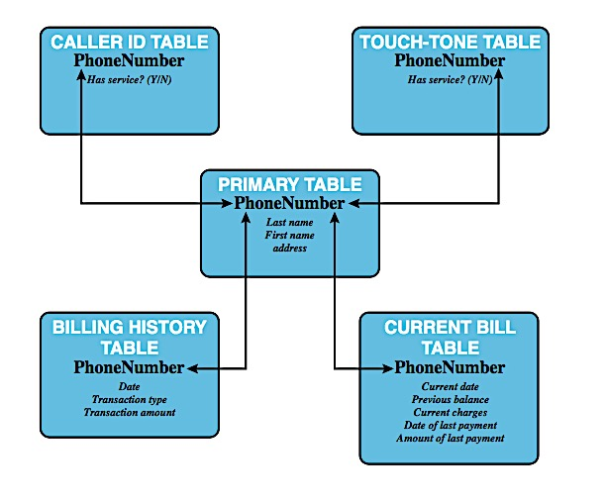
Example of RDBMS
A relational database uses multiple tables related to one another by a designated key; in this case the key is the Phone-Number field.
Notes:
For example, a typical telephone directory contains one entry for each subscriber, with columns for name, telephone number, and address. Such a table is called a flat file because it is a single two-dimensional data. In a flat file, all of the data are stored in a single table. For the telephone directory, there might be a number of subscribers with the same name, but the telephone numbers should be unique, so that the telephone number serves as a unique identifier for a row. However, two or more people sharing the same phone number might each be listed in the directory, but with the same telephone number, which is no longer unique.
Figure 5.2 here shows how new services and features can be added to the telephone database without reconstructing the main table. In this example, there is a primary table with basic information for each telephone number. The telephone number serves as a primary key.
A query language allows the user to request selected items of data from all records that fit a given set of criteria. For example, a telephone company representative could retrieve a subscriber's billing information as well as the status of special services or the latest payment received, all displayed on one screen.

Slide 7
Relational Database Elements
Formal Name | Common Name | Also Known As
Relation | Table | File
Tuple | Row | Record
Attribute | Column | Field
Primary key
Uniquely identifies a row
Foreign key
Links one table to attributes in another
View / virtual table
Notes:
In relational database parlance, the basic building block is a relation, which is a flat table. Rows are referred to as tuples, and columns are referred to as attributes. A primary key is used to uniquely identify a row in a table; the primary key consists of one or more column names. In the example of Figure 5.2, a single attribute, PhoneNumber is sufficient to uniquely identify a row in a particular table. To create a relationship between two tables, the attributes that define the primary key in one table must appear as attributes in another table, where they are referred to as a foreign key. Whereas the value of a primary key must be unique for each tuple (row) of its table, a foreign key value can appear multiple times in a table, so that there is a one-to-many relationship between a row in the table with the primary key and rows in the table with the foreign key. A view is a virtual table. In essence, a view is the result of a query that returns selected rows and columns from one or more tables. Views are often used for security purposes. A view can provide restricted access to a relational database so that a user or application only has access to certain rows or columns.

Slide 8
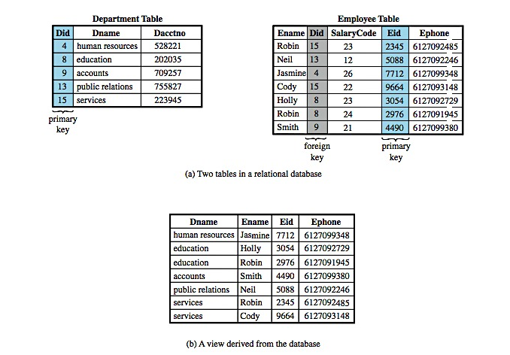
Relational Database Elements
Notes:
Figure 5.3a here provides an example of related tables. In the Department Table, the department ID (Did) is the primary key; each value is unique. This table gives the ID, name and account number for each department. The Employee Table contains the name, salary code, employee ID, and phone number of each employee. The Employee Table also indicates the department to which each employee is assigned by including Did. Did is identified as a foreign key and provides the relationship between the employee table and the department table.
Figure 5.3b illustrates a view that includes the employee name, ID and phone number from the Employee Table and the corresponding department name from the Department Table. The linkage is the Did, so that the view table includes data from each row of the Employee Table, with additional data from the Department Table. It is also possible to construct a view from a single table. For example, one view of the Employee Table consists of all rows, with the salary code column deleted. A view can be qualified to include only some rows and/or some columns. For example, a view can be defined consisting of all rows in the Employee Table for which the Did = 15.

Slide 9
Structured Query Language
Structure query language (SQL)
Originally developed by IBM in the mid-1970s
Standardized language to define, manipulate, and query data in a relational database
Several similar versions of ANSI/ISO standard
CREATE TABLE department (
Did INTEGER PRIMARY KEY, Dname CHAR (30), Dacctno CHAR (6) )
CREATE TABLE employee ( Ename CHAR (30), Did INTEGER, SalaryCode INTEGER, Eid INTEGER PRIMARY KEY, Ephone CHAR (10), FOREIGN KEY (Did) REFERENCES department (Did) )
CREATE VIEW newtable (Dname, Ename, Eid, Ephone)
AS SELECT D.Dname E.Ename, E.Eid, E.Ephone
FROM Department D Employee E
WHERE E.Did = D.Did
Notes:
Structure Query Language (SQL), originally developed by IBM in the mid-1970s, is a standardized language that can be used to define, manipulate, and query the data in a relational database. There are several versions of the ANSI/ISO standard and a variety of different implementations, but all follow the same basic syntax and semantics. For example, the two tables in Figure 5.3a are defined as shown lower left. The basic command for retrieving information is the SELECT statement. SQL statements can be used to create tables, insert and delete data in tables, create views, and retrieve data with query statements. The view in Figure 5.3bis created using the SQL statement shown lower right.

Slide 10

SQL Injection Attack

Slide 11
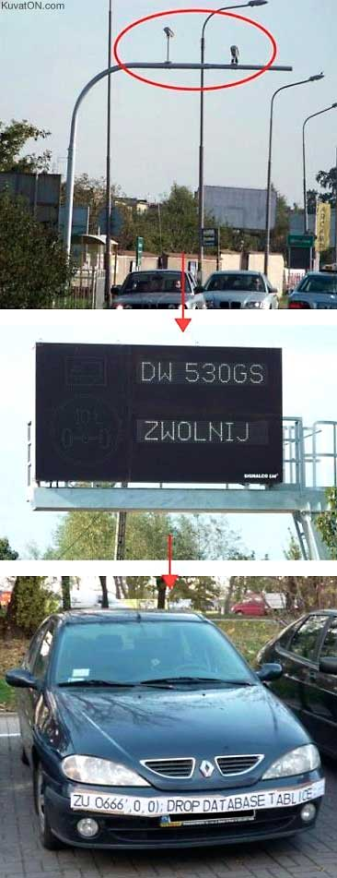

Slide 12
What is a SQL Injection Attack?
Many web applications take user input from a form
Often this user input is used literally in the construction of a SQL query submitted to a database. For example:
SELECT productdata FROM table WHERE productname = ‘user input product name;
A SQL injection attack involves placing SQL statements in the user input

Slide 13
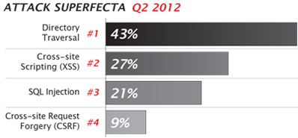
SQL Injection Attacks on the rise
https://www.net-security.org/secworld.php?id=13313
“Many, many sites have lost customer data in this way,” said Chris Hinkley, Senior Security Engineer at FireHost. “SQL Injection attacks are often automated and many website owners may be blissfully unaware that their data could actively be at risk. These attacks can be detected and businesses should be taking basic and blanket steps to block attempted SQL Injection, as well as the other types of attacks we frequently see.”
Notes:
One of the most significant changes in attack traffic seen between Q1 and Q2 2012 was a 69% increase in SQL Injection attacks. Rising from 277,770 blocked attacks in the first quarter, to 469,983 between April and June, this type of attack is frequently cited as an attack vector of choice for data thieves.

Slide 14
News of SQL attacks
http://www.mysqlperformanceblog.com/2012/07/18/sql-injection-still-a-problem/
An SQL injection vulnerability resulted in an urgent June bugfix release of Ruby on Rails 3.x.
Yahoo! Voices was hacked in July. The attack acquired 453,000 user email addresses and passwords. The perpetrators claimed to have used union-based SQL injection to break in.
LinkedIn.com leaked 6.5 million user credentials in June. A class action lawsuit alleges that the attack was accomplished with SQL injection.
SQL injection was documented as a security threat in 1998, but new incidents still occur every month. Making honest mistakes, developers fail to defend against this means of attack, and the security of online data is at risk for all of us because of it.

Slide 15
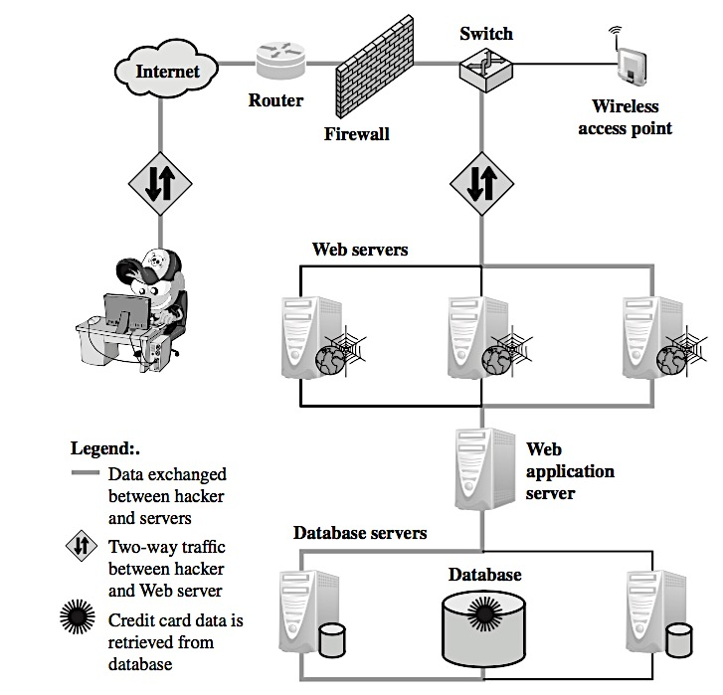
Typical SQL Injection Attack
2
The Web server receives the malicious code and sends it to the Web application server
6
The Web server sends the credit card details to the hacker
5
The Web application server dynamically generates a page with data including credit card details from the database
4
The database server executes the malicious code on the database. The database returns data from credit cards table
3
The Web application server receives the malicious code from the Web server and sends it to the database server
1
Hacker finds a vulnerability in a custom Web application and injects an SQL command to a database by sending the command to the Web server. The command is injected into traffic that will be accepted by the firewall.

Slide 16
An Example SQL Injection Attack
Product Search:
This input is put directly into the SQL statement within the Web application:
$query = “SELECT prodinfo FROM prodtable WHERE prodname = ‘” . $_POST[‘prod_search’] . “’”;
Creates the following SQL:
SELECT prodinfo FROM prodtable WHERE prodname = ‘blah‘ OR ‘x’ = ‘x’
Attacker has now successfully caused the entire database to be returned.
blah‘ OR ‘x’ = ‘x’

Slide 17
A More Malicious Example
What if the attacker had instead entered:
blah‘; DROP TABLE prodinfo; --
Results in the following SQL:
SELECT prodinfo FROM prodtable WHERE prodname = ‘blah’; DROP TABLE prodinfo; --’
Note how comment (--) consumes the final quote
Causes the entire database to be deleted
Depends on knowledge of table name
This is sometimes exposed to the user in debug code called during a database error
Use non-obvious table names, and never expose them to user
Usually data destruction is not your worst fear, as there is low economic motivation

Slide 18
Other injection possibilities
Using SQL injections, attackers can:
Add new data to the database
Could be embarrassing to find yourself selling politically incorrect items on an eCommerce site
Perform an INSERT in the injected SQL
Modify data currently in the database
Could be very costly to have an expensive item suddenly be deeply ‘discounted’
Perform an UPDATE in the injected SQL
Often can gain access to other user’s system capabilities by obtaining their password

Slide 19
SQLi Attack Avenues and Types
User Input
attackers inject SQL commands by providing suitably crafted user input
user input typically comes from form submissions that are sent to the Web application via HTTP GET or POST requests
Server Variables
If these variables are logged to a database without sanitization, this could create an SQL injection vulnerability
When the query to log the server variable is issued to the database, the attack in the forged header is then triggered
Second-order Injection
A malicious user could rely on data already present in the system or database to trigger an SQL injection attack
Such attack does not come from the user, but from within the system itself
Cookies
An attacker could alter cookies such that when the application server builds an SQL query based on the cookie’s content, the structure and function of the query is modified
Physical User Input
Such user-input could take the form of conventional barcodes, RFID tags, or even paper forms which are scanned using optical character recognition and passed to a database management system

Slide 20
SQLi Countermeasures
Defensive Coding
Detection
Manual defensive coding practices
An example is input type checking, to check that inputs that are supposed to be numeric contain no characters other than digits
Parameterized query insertion
SQL DOM
query-building process
Signature based
Anomaly based
Code analysis

Slide 21
Database Access Control
DBMS provide access control for database
Assume have authenticated user
DBMS provides specific access rights to portions of the database
e.g. Create, Insert, Delete, Update, Read, Write
To entire database, tables, selected rows or columns
Possibly dependent on contents of a table entry
Can support a range of policies:
Centralized administration
Ownership-based administration
Decentralized administration
Notes:
Commercial DBMSs typically provide an access control capability for the database. The DBMS operates on the assumption that the computer system has authenticated each user. For users that are authenticated and granted access to the database, database access control system provides a specific capability that controls access to portions of the database. Commercial DBMSs provide discretionary or role-based access control. Typically, a DBMS can support a range of administrative policies, including:
• Centralized administration: A small number of privileged users may grant and revoke access rights.
• Ownership-based administration: The owner (creator) of a table may grant and revoke access rights to the table.
• Decentralized administration: In addition to granting and revoking access rights to a table, the owner of the table may grant and revoke authorization to other users, allowing them to grant and revoke access rights to the table.
As with any access control system a database access control system distinguishes different access rights, including create, insert, delete, update, read, and write. Some DBMSs provide considerable control over the granularity of access rights. Access rights can be to the entire database, to individual tables, or to selected rows or columns within a table. Access rights can be determined based on the contents of a table entry. For example, in a personnel database, some users may be limited to seeing salary information only up to a certain maximum value. And a department manager may only be allowed view salary information for employees in his or her department.

Slide 22
SQL Access Controls
two commands:
GRANT { privileges | role } [ON table] TO { user | role | PUBLIC } [IDENTIFIED BY password] [WITH GRANT OPTION]
e.g. GRANT SELECT ON ANY TABLE TO ricflair
REVOKE { privileges | role } [ON table] FROM { user | role | PUBLIC }
e.g. REVOKE SELECT ON ANY TABLE FROM ricflair
typical access rights are:
SELECT, INSERT, UPDATE, DELETE, REFERENCES
Notes:
SQL provides two commands for managing access rights, GRANT and REVOKE. For different versions of SQL, the syntax is slightly different. The GRANT command can be used to grant one or more access rights or can be used to assign a user to a role. For access rights, the command can optionally specify that it applies only to a specified table. The TO clause specifies the user or role to which the rights are granted. A PUBLIC value indicates that any user has the specified access rights. The optional IDENTIFIED BY clause specifies a password that must be used to revoke the access rights of this GRANT command. The GRANT OPTION indicates that the grantee can grant this access right to other users, with our without the grant option. Consider the simple example shown, which enables user ricflair to query any table in the database. The REVOKE command has the syntax shown. The example revokes the access rights of the preceding example.
Different implementations of SQL provide different ranges of access rights, e.g.:
• SELECT: Grantee may read entire database; individual tables; or specific columns in a table.
• INSERT: Grantee may insert rows in a table; or insert rows with values for specific columns in a table.
• UPDATE: Semantics is similar to INSERT.
• DELETE: Grantee may delete rows from a table.
• REFERENCES: Grantee is allowed to define foreign keys in another table that refer to the specified columns.

Slide 23
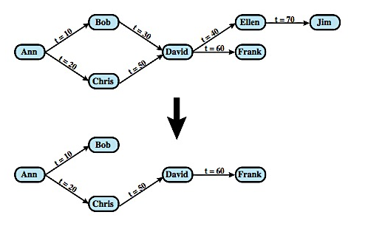
Cascading Authorizations
Notes:
The grant option enables an access right to cascade through a number of users. We consider a specific access right and illustrate the cascade phenomenon in Figure 5.4. The figure indicates that Ann grants the access right to Bob at time t = 10 and to Chris at time t = 20. Assume that the grant option is always used. Thus, Bob is able to grant the access right to David at t = 30. Chris redundantly grants the access right to David at t = 50. Meanwhile, David grants the right to Ellen, who in turn grants it to Jim; and subsequently David grants the right to Frank.
Just as the granting of privileges cascades from one user to another using the grant option, the revocation of privileges also cascaded. Thus, if Ann revokes the access right to Bob and Chris, than the access right is also revoked to David, Ellen, Jim, and Frank. A complication arises when a user receives the same access right multiple times, as happens in the case of David. Suppose that Bob revokes the privilege from David. David still has the access right because it was granted by Chris at t = 50. However, David granted the access right to Ellen after receiving the right, with grant option, from Bob but prior to receiving it from Chris. Most implementations dictate that in this circumstance, the access right to Ellen and therefore Jim is revoked when Bob revokes the access right to David. This is because at t = 40, when David granted the access right to Ellen, David only had the grant option to do this from Bob. When Bob revokes the right, this causes all subsequent cascaded grants that are traceable solely to Bob via David to be revoked. Because David granted the access right to Frank after David was granted the access right with grant option from Chris, the access right to Frank remains. These effects are shown in the bottom of Figure 5.4.

Slide 24
Role-Based Access Control
Role-based access control work well for DBMS
Eases admin burden, improves security
Categories of database users:
Application owner
End user
Administrator
DB RBAC must manage roles and their users
Cf. RBAC on Microsoft’s SQL server
Notes:
A role-based access control (RBAC) scheme is a natural fit for database access control. Unlike a file system associated with a single or a few applications, a database system often supports dozens of applications. In such an environment, an individual user may use a variety of applications to perform a variety of tasks, each of which requires its own set of privileges. RBAC provides a means of easing the administrative burden and improving security. In a discretionary access control environment, we can classify database users in three broad categories:
• Application owner: An end user that owns database objects (tables, columns, rows) as part of an application. The application owner may assign roles to end users.
• End user other than application owner: An end user that operates on database objects via a particular application but does not own any of the database objects.
• Administrator: User who has administrative responsibility for part of all of the database. Administrators are responsible for more sensitive or general roles, including those having to do with managing physical and logical database components, such as data files, users, and security mechanisms. The system needs to be set up to give certain administrators certain privileges. Administrators in turn can assign users to administrative-related roles.
A database RBAC facility needs to be able to: create and delete roles; define permissions for a role, assign and cancel assignment of users to roles.
A good example of the use of roles in database security is the RBAC facility provided by Microsoft SQL Server. SQL Server supports three types of roles: server roles, database roles, and user-defined roles. See text for details.

Slide 25
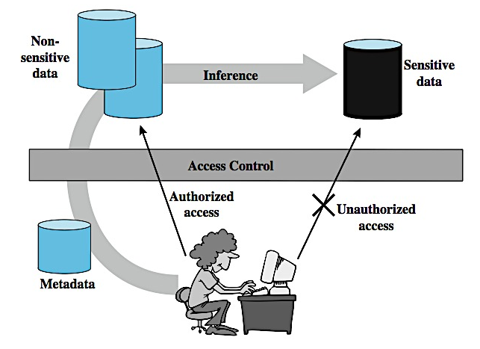
Inference
Indirect Information Access via Inference Channel
Notes:
Inference, as it relates to database security, is the process of performing authorized queries and deducing unauthorized information from the legitimate responses received. The inference problem arises when the combination of a number of data items is more sensitive than the individual items, or when a combination of data items can be used to infer data of a higher sensitivity. Figure 5.5here illustrates the process. The attacker may make use of nonsensitive data as well as metadata. Metadata refers to knowledge about correlations or dependencies among data items that can be used to deduce information not otherwise available to a particular user. The information transfer path by which unauthorized data is obtained is referred to as an inference channel. In general terms, two inference techniques can be used to derive additional information: analyzing functional dependencies between attributes within a table or across tables; and merging views with the same constraints.

Slide 26
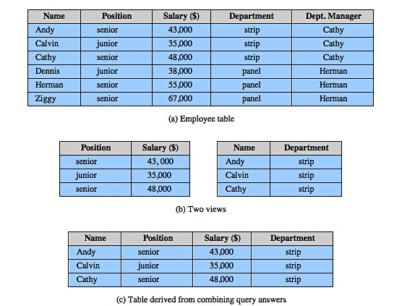
Inference Example
CREATE view V1 AS
SELECT Availability, Cost
FROM Inventory
WHERE Department = ”hardware”
CREATE view V2 AS
SELECT Item, Department
FROM Inventory
WHERE Department = ”hardware”
Notes:
An example of inference across tables is shown in Figure 5.6. Figure 5.6a shows a table Employee with five columns. Figure 5.6b shows two views. Users of these views are not authorized to access the relationship between Name and Salary. A user who has access to either or both views cannot infer the relationship by functional dependencies. That is, there is not a functional relationship between Name and Salary such that knowing Name and perhaps other information is sufficient to deduce Salary. However, suppose the two views are created with the access constraint that Name and Salary cannot be access together. A user who knows the structure of the Employee table and who knows that the view tables maintain the same row order as the Employee table is then able to merge the two views to construct the table shown in Figure 5.6c. This violates the access control policy that the relationship of attributes Name and Salary must not be disclosed.

Slide 27
Inference Countermeasures
Inference detection at database design
Alter database structure or access controls
Inference detection at query time
By monitoring and altering or rejecting queries
Need some inference detection algorithm
A difficult problem
Cf. Employee-salary example
Notes:
There are two approaches to dealing with the threat of disclosure by inference.
• Inference detection during database design: removes an inference channel by altering the database structure or by changing the access control regime to prevent inference. Examples include removing data dependencies by splitting a table into multiple tables or using more fine-grain access control roles in an RBAC scheme.
• Inference detection at query time: eliminate an inference channel violation during a query or series of queries. If inference channel detected, query is denied or altered.
For either of the preceding approaches, some inference detection algorithm is needed. This is a difficult problem and the subject of ongoing research. Consider a database containing personnel information, including names addresses, and salaries of employees. Individually, the name, address, and salary information is available to a subordinate role, such as Clerk, but the association of names and salaries is restricted to a superior role, such as Administrator. One solution to this problem is to construct three tables. The Employees Table and the Salaries Table are accessible to the Clerk role, but the Emp-Salary table is only available to the Administrator role. In this structure, the sensitive relationship between employees and salaries is protected from users assigned the Clerk role. Now suppose we add a new attribute, employee start date, which is not sensitive. This could be added to the Salaries table. However, an employee's start data is an easily observable or discoverable attribute of an employee. Thus a user in the Clerk role should be able to infer (or partially infer) the employee's name. This would compromise the relationship between employee and salary. Hence we should add the Start-Date column to the Employees Table instead.

Slide 28
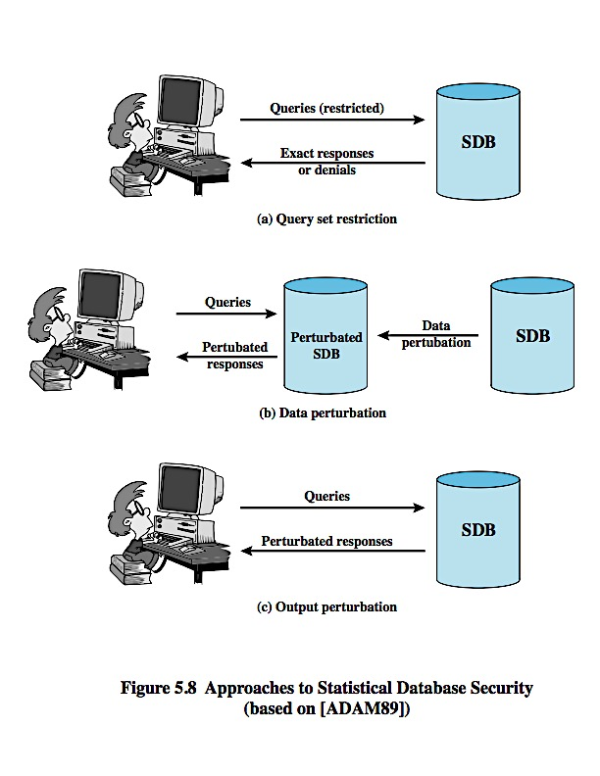
Protecting Against Inference
Notes:
SDB implementers have developed two distinct approaches to protection of an SDB from inference attacks (Figure 5.8).
Query restriction: Rejects a query that can lead to a compromise. The answers provided are accurate. Query restriction techniques defend against inference by restricting statistical queries so that they do not reveal user confidential information. Restriction in this context simply means that some queries are denied. The simplest form of query restriction is query size restriction. For a database of size N (number of rows, or records), a query q(C) is permitted only if the number of records that match C satisfies: k <= |X(C)| <= N-k, where k is a fixed integer greater than 1. Thus, the user may not access any query set of less than k records. Note that the upper bound is also needed. The upper bound of N – k guarantees that the user does not have access to statistics on query sets of less than k records. In practice, queries of the form q(All) are allowed, enabling users to easily access statistics calculated on the entire database. Query size restriction counters attacks based on very small query sets.
Perturbation: Provides answers to all queries, but the answers are approximate, due to the addition of noise to the statistics generated from the original data. This can be done in one of two ways: the data in the SDB can be modified (perturbed) so as to produce statistics that cannot be used to infer values for individual records( data perturbation). Alternatively, when a statistical query is made, the system can generate statistics that are modified from those that the original database would provide, again thwarting attempts to gain knowledge of individual records (output perturbation). Regardless of the specific perturbation technique, the designer must attempt to produce statistics that accurately reflect the underlying database.

Slide 29
Statistical Databases
Provides data of a statistical nature
e.g. Counts, averages
Two types:
Pure statistical database
Ordinary database with statistical access
Some users have normal access, others statistical
Access control objective to allow statistical use without revealing individual entries
Security problem is one of inference
Notes:
A statistical database (SDB) is one that provides data of a statistical nature, such as counts and averages. The term statistical database is used in two contexts:
• Pure statistical database: This type of database only stores statistical data. An example is a census database. Typically, access control for a pure SDB is straightforward: certain users are authorized to access the entire database.
• Ordinary database with statistical access: This type of database contains individual entries; this is the type of database discussed so far in this chapter. The database supports a population of nonstatistical users who are allowed access to selected portions of the database using DAC, RBAC, or MAC. In addition, the database supports a set of statistical users who are only permitted statistical queries. For these latter users, aggregate statistics based on the underlying raw data are generated in response to a user query, or may be pre-calculated and stored as part of the database. We are mainly concerned with this type of SDB.
The access control objective for an SDB system is to provide users with the aggregate information without compromising the confidentiality of any individual entity represented in the database. The security problem is one of inference. The database administrator must prevent, or at least detect, the statistical user who attempts to gain individual information through one or a series of statistical queries.

Slide 30
Statistical Database Security
Use a characteristic formula C
A logical formula over the values of attributes
e.g. (gender=male) AND ((major=cs) OR (major=ee))
Query set X(C) of characteristic formula C, is the set of records matching C
A statistical query is a query that produces a value calculated over a query set
Notes:
Statistics are derived from a database by means of a characteristic formula, C, which is a logical formula over the values of attributes. A characteristic formula uses the operators OR, AND, and NOT (+ . ~). A characteristic formula specifies a subset of the records in the database. The example specifies all male students majoring in either CS or EE. For numerical attributes, relational operators may be used. The query set of characteristic formula C, denoted as X(C), is the set of records matching that characteristic. A statistical query is a query that produces a value calculated over a query set. Some simple statistics that can be derived from a query set are count, sum, average, median, max, min.
A statistical user of an underlying database of individual records is restricted to obtaining only aggregate, or statistical, data from the database and is prohibited access to individual records. The inference problem in this context is that a user may infer confidential information about individual entities represented in the SDB, Such an inference is called a compromise. In some cases, a sequence of queries may reveal information.
In general terms, the inference problem for an SDB can be stated as follows. A characteristic function C defines a subset of records (rows) within the database. A query using C provides statistics on the selected subset. If the subset is small enough, perhaps even a single record, the questioner may be able to infer characteristics of a single individual or a small group. Even for larger subsets, the nature or structure of the data may be such that unauthorized information may be released.

Slide 31
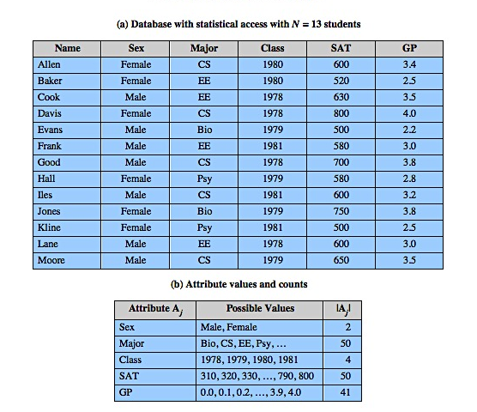
Statistical Database Example
Notes:
The example shown here from Table 5.3 is a database containing 13 confidential records of students in a university that has 50 departments.
A characteristic formula C specifies a subset of the records in the database. For example C = (GP > 3.7) specifies all students whose grade point average exceeds 3.7.
The query set of is the set of records matching some characteristic C. For example, for C = Female CS, X(C) consists of records 1 and 4, the records for Allen and Davis.
A statistical query is a query that produces a value calculated over a query set. Examples: count(Female . CS) = 2; sum(Female . CS, SAT) = 1400.
The inference problem is that a user may infer confidential information about individual entities represented in the SDB. For example, the statistic sum(EE Female, GP) = 2.5 compromises the database if the user knows that Baker is the only female EE student. In some cases, a sequence of queries may reveal information. For example, suppose a questioner knows that Baker is a female EE student, but does not know if she is the only one. Consider the following sequence of two queries that reveals the sensitive information:
count(EE Female) = 1
sum(EE Female, GP) = 2.5

Slide 32
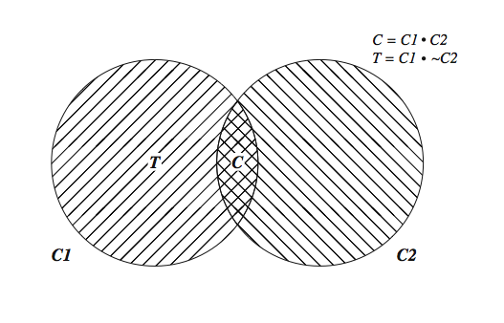
Tracker Attacks
Divide queries into parts
C = C1.C2
Count(C.D) = count(C1) - count (C1. ~C2)
Combination is called a tracker
Each part acceptable query size
Overlap is desired result
Notes:
Although query size restriction can prevent trivial attacks, it is vulnerable to more sophisticated attacks, such as the use of a tracker. Here the questioner divides his knowledge of an individual into parts, such that queries can be made based on the parts without violating any query size restrictions. The combination of parts is called a tracker, because it can be used to track down characteristics of an individual. Consider the formula C.D that corresponds to zero or one record, so that the query count(C.D) is not permitted. But suppose that the formula C can be decomposed into two parts C = C1.C2, such that the query sets for both C1 and T = (C1.~C2) satisfy the query size restriction. Figure 5.9 here illustrates this situation. The following formula can be used to determine if count(C) = 1: count(C) = count(C1) – count(T). That is, you count the number of records in C1, and then subtract the number of records that are in C1 but not in C2. The result is the number of records that are in both C1 and C2, which is equal to the number of records in C. By a similar reasoning, it can be shown that we can determine whether I has attribute D with: count(C.D) = count(T+C1.D)–count(T). It can be shown that more sophisticated tracker attacks may succeed even against large databases in which the threshold k is set at a relatively high level.
For example, in Table 5.3, Evans is identified by C = Male.Bio.1979. Let k = 3. We can use T = (C1.~C2) = Male.~(Bio.1979). Both C1 and C2 satisfy the query size restriction. We then determine that Evans is uniquely identified by C and whether his SAT score is at least 600:
count(Male.Bio.1979) = count(Male) – count(Male. ~(Bio.1979)) = 7– 6 = 1
count((Male.Bio.1979).(SAT ≥ 600)) = count((Male.~(Bio.1979)+(Male.(SAT≥600))) – count(Male.~(Bio.1979)) = 6–6 = 0

Slide 33
Other Query Restrictions
Query Set Overlap Control
Limit Overlap Between New & Previous Queries
Has Problems And Overheads
Partitioning
Cluster Records Into Exclusive Groups
Only Allow Queries On Entire Groups
Query Denial And Information Leakage
Denials Can Leak Information
To Counter Must Track Queries From User
Notes:
A number of other query restriction approaches have been studied, all of which have their own vulnerabilities. However, several of these techniques in combination do reduce vulnerability.
A query size restriction is defeated by issuing queries in which there is considerable overlap in the query sets. To counter this, query set overlap control limits queries from a user so that any new query combined with any previous queries spans less than some limited number of records. This technique has a number of problems: it is ineffective for preventing the cooperation of several users to compromise the database; statistics for both a set and its subset (e.g. all patients and all patients undergoing treatment) cannot be released, thus limiting the usefulness of the database; and for each user, a user profile has to be kept up to date.
Partitioning can be viewed as taking query set overlap control to its logical extreme, by not allowing overlapping queries at all. With partitioning, the records in the database are clustered into a number of mutually exclusive groups, e.g. values for a given year. The user may only query the statistical properties of each group as a whole. Partitioning solves some security problems, but has some drawbacks. The users ability to extract useful statistics is reduced, and there is a design effort in constructing and maintaining the partitions.
A general problem with query restriction techniques is that the denial of a query may provide sufficient clues that an attacker can deduce/leak underlying information. In an approach to counter this threat, the system monitors all queries from a given source and decides on the basis of the queries so far posed whether to deny a new query. The decision is based solely on the history of queries and answers and the new query.

Slide 34
Perturbation
Add Noise To Statistics Generated From Data
Will Result In Differences In Statistics
Data Perturbation Techniques
Data Swapping
Generate Statistics From Probability Distribution
Output Perturbation Techniques
Random-sample Query
Statistic Adjustment
Must Minimize Loss Of Accuracy In Results
Notes:
Another technique to thwart inference attacks, is to add noise to the statistics generated from the original data, in one of two ways as shown earlier. Regardless of the specific perturbation technique, the designer must attempt to produce statistics that accurately reflect the underlying database. Because of the perturbation, there will be differences between perturbed results and ordinary results from the database. However, the goal is to minimize the differences and to provide users with consistent results.
Data Perturbation Techniques include two methods. The first method is referred to as data swapping. In this method, attribute values are exchanged (swapped) between records in sufficient quantity so that nothing can be deduced from the disclosure of individual records. The swapping is done in such a way that the accuracy of at least low-order statistics is preserved. The second method is to generate statistics from the assumed underlying probability distribution for each confidential or sensitive attribute, and to substitute generated data for the confidential attribute for the original data in the same rank order.
Output Perturbation Techniques include random-sample query, where the system replaces X(C), the desired query set, with a sampled query set which is a properly selected subset of X(C), and returns the statistics for this subset. Other approaches to output perturbation involve calculating the statistic on the requested query set and then adjusting the answer up or down by a given amount in some systematic or randomized fashion. All of these techniques are designed to thwart tracker attacks and other attacks that can be made against query restriction techniques.
With all of the perturbation techniques, there is a potential loss of accuracy as well as the potential for a systematic bias in the results.

Slide 35
Database Encryption
Databases Typical A Valuable Info Resource
Protected By Multiple Layers Of Security: Firewalls, Authentication, O/S Access Control Systems, DB Access Control Systems, And Database Encryption
Can Encrypt
Entire Database - Very Inflexible And Inefficient
Individual Fields - Simple But Inflexible
Records (Rows) Or Columns (Attributes) - Best
Also Need Attribute Indexes To Help Data Retrieval
Varying Trade-offs
Notes:
The database is typically the most valuable information resource for any organization and is therefore protected by multiple layers of security, including firewalls, authentication mechanisms, general access control systems, and database access control systems, and for particularly sensitive data database encryption. Encryption can be applied to the entire database, at the record level (encrypt selected records), at the attribute level (encrypt selected columns), or at the level of the individual field.
One approach is to encrypt the entire database and not provide the encryption/ decryption keys to the service provider. This solution, by itself is inflexible. The user has little ability to access individual data items based on searches or indexing on key parameters, but rather would have to download entire tables from the database, decrypt the tables, and work with the results. To provide more flexibility, it must be possible to work with the database in its encrypted form. The simplest possible arrangement is that each individual item in the database is encrypted separately, all using the same encryption key. The encrypted database is stored at the server, but the server does not have the key, so that the data is secure at the server. The client system does have a copy of the encryption key, so can encrypt fields to check in the query and decrypt returned results. This method is straightforward but lacks flexibility. The set of encrypted values do not preserve the ordering of values in the original attribute. To provide more flexibility, each record (row) of a table in the database is encrypted as a block. To assist in data retrieval, attribute indexes are associated with each table. For some or all of the attributes an index value is created. This arrangement provides for more efficient data retrieval, but does leak rough ordering info to any attacker.

Slide 36
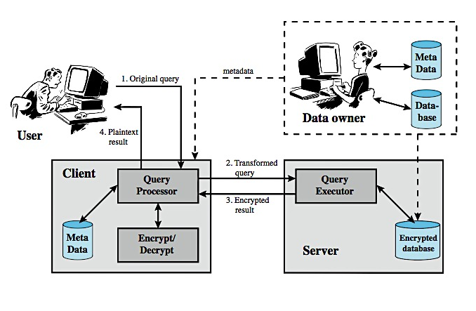
Database Encryption
Notes:
A database encryption example is depicted in Figure 5.10. Four entities are involved:
• Data owner: organization that produces the sensitive data
• User: that presents requests (queries) to the system.
• Client: Front-end that transforms user queries into queries on encrypted data
• Server: that receives encrypted data from a data owner and makes them available for distribution to clients. The server could in fact be owned by the data owner but more typically, is owned and maintained by an external provider.
Suppose that each individual item in the database is encrypted separately, all using the same encryption key. The encrypted database is stored at the server, but the server does not have the key, so that the data is secure at the server. The client system does have a copy of the encryption key. A user at the client can retrieve a record from the database with the following sequence:
1. The user issues an SQL query for fields from one or more records with a specific value of the primary key.
2. The query processor at the client encrypts the primary key, modifies the SQL query accordingly, and transmits the query to the server.
3. The server processes the query using the encrypted value of the primary key and returns the appropriate record or records.
4. The query processor decrypts the data and returns the results.

Slide 37
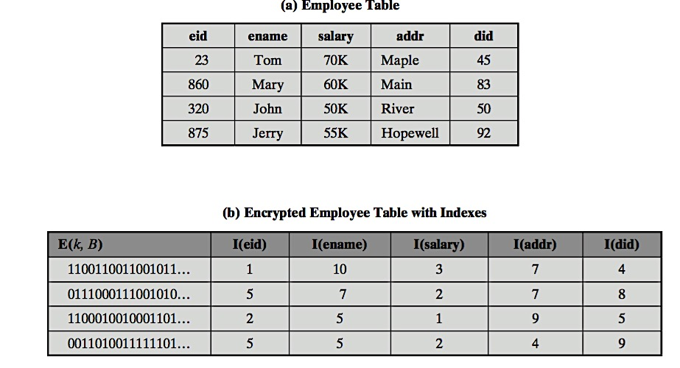
Encrypted Database Example
For example, the eid values could be partitioned by mapping [1, 200], [201, 400], [401, 600], [601, 800], and [801, 1000] into 2, 3, 5, 1, and 4, respectively

Slide 38
Summary
Introduced databases and DBMS
Relational databases
SQL injection
Database access control issues
SQL, role-based
Inference
Statistical database security issues
Database encryption
Notes:
Chapter 5 summary.

